Slide 1
Unidata’s TDS Workshop TDS Overview – Part II
22-24 October 2012

Slide 2
THREDDS Data Server
Servlet Container
catalog.xml
Remote Access
Client
THREDDS Server
WCS
OPeNDAP
HTTPServer
WMS
NetCDF-Java
Library
configCatalog.xml
IDD Data
Datasets
thredds.ucar.edu

Slide 3
THREDDS Data Server
Servlet Container
catalog.xml
Remote Access
Client
THREDDS Server
WCS
OPeNDAP
HTTPServer
WMS
NetCDF-Java
Library
configCatalog.xml
IDD Data
Datasets
thredds.ucar.edu

Slide 4
Common Data Model (CDM)
Implemented in the netCDF-Java library (3 layers)
NetCDF Data Access:
Access to array-based scientific data (netCDF data model)
Read various file formats, map into data model (IOSP)
NetcdfDataset:
Geospatial coordinate systems (conventions)
NcML: Modify existing dataset
Aggregation of datasets
Scientific Feature Types, e.g.:
Gridded Data; Radial Data; Swath Data
Discrete Sampling Features:
Point Data; Station Data; Profile Data
Trajectory (e.g., aircraft track) Data

Slide 5
Application
Scientific Feature Types
Datatype Adapter
NetCDF-Java/
CDM architecture
NetcdfDataset
CoordSystem Builder
NetcdfFile
THREDDS
I/O service provider
Catalog.xml
OPeNDAP
NetCDF-3
NIDS
NetCDF-4
GRIB
NcML
HDF5
GINI
Nexrad
DMSP

Slide 6
CDM: Coordinate Systems
Used to geolocate data
Dataset must describe the coordinate systems used
Use conventions to describe coordinate systems
CF Convention (recommended)
Other conventions are recognized by netCDF-Java library
What you get if your data follows conventions
Standard visualization, debugging, and data manipulation tools
Standard servers to make your data remotely accessible

Slide 7
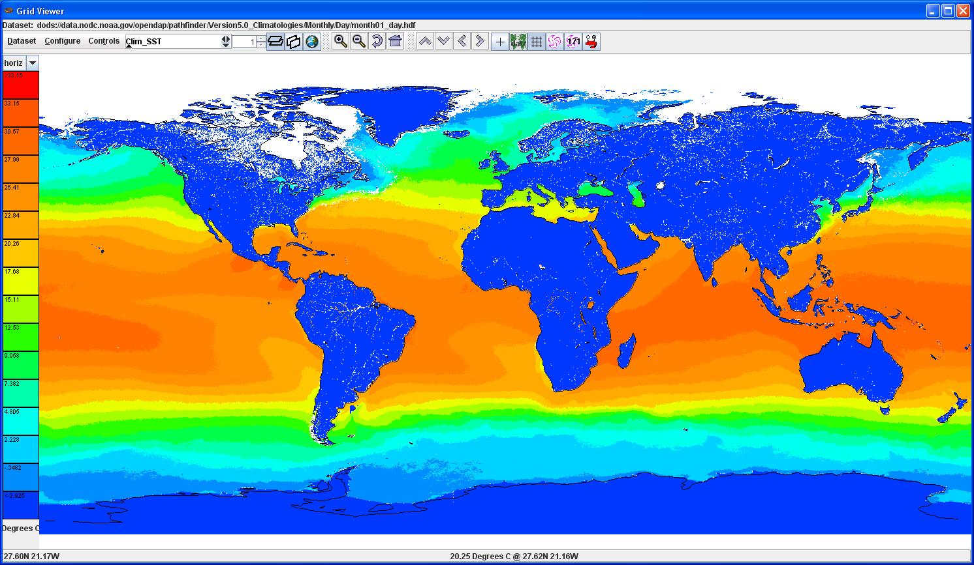
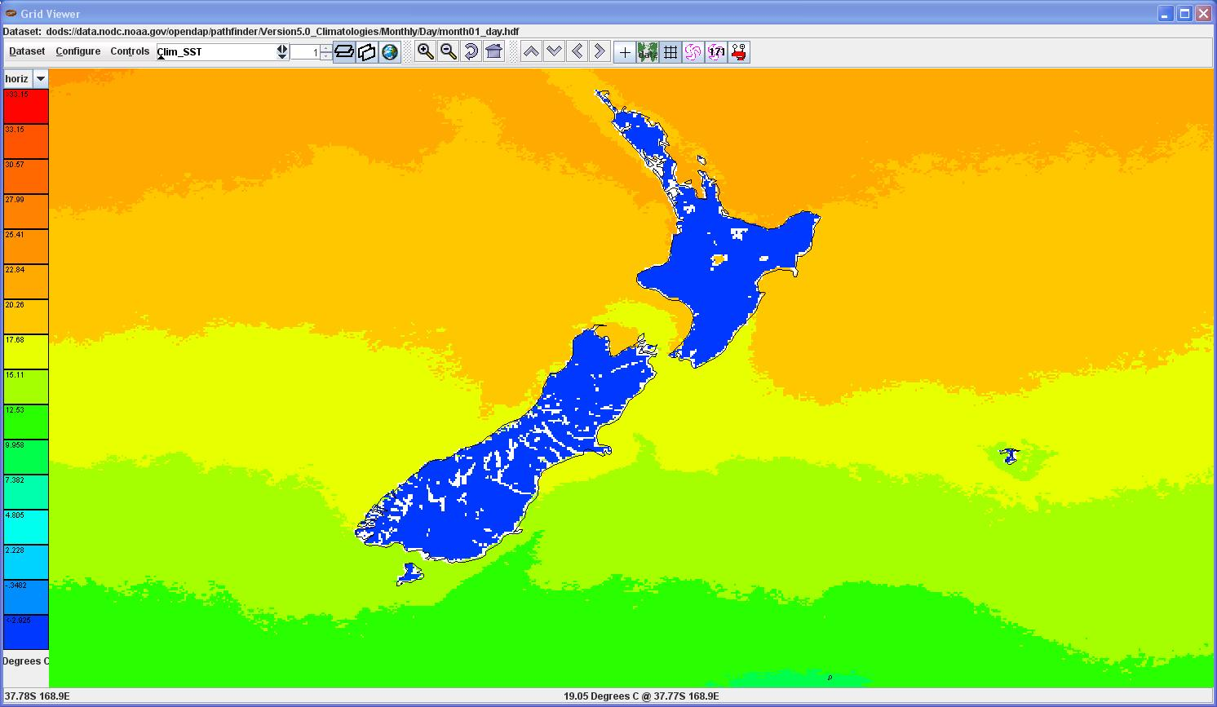
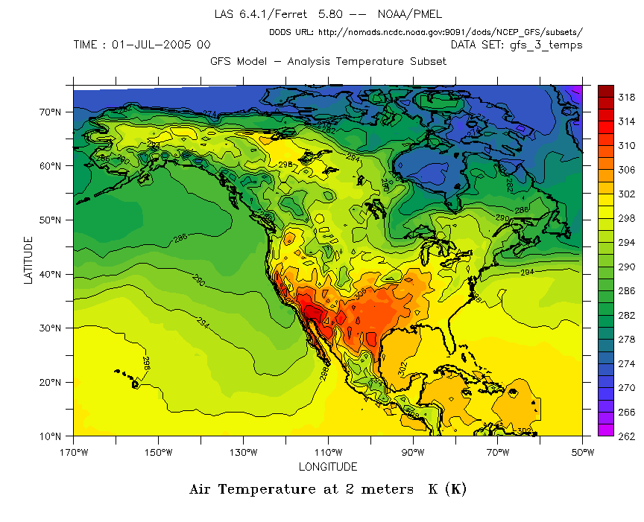
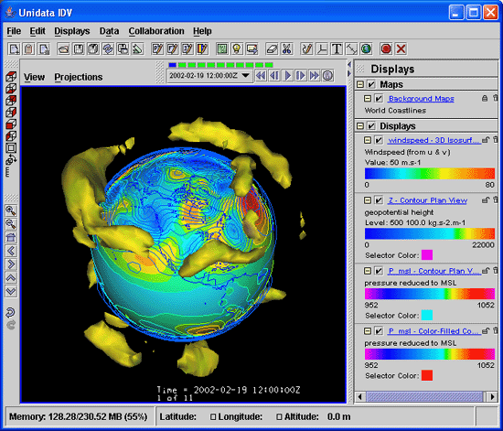
CDM: Coordinate Systems

Slide 8
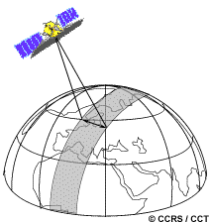
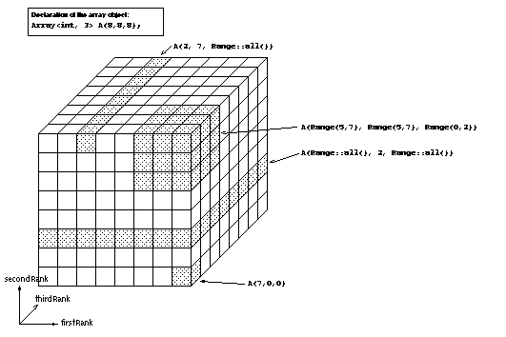
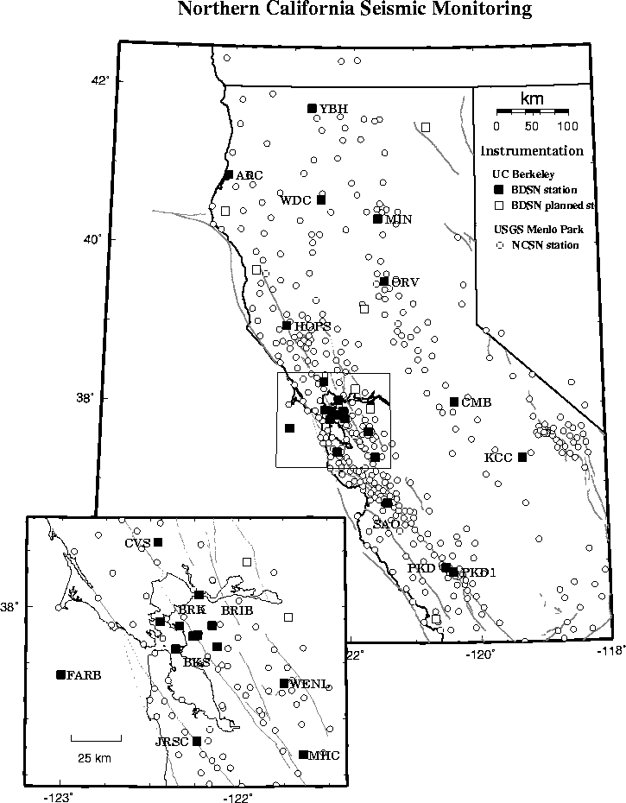
CDM: Scientific Feature Types
Gridded Data
Radial Data
Swath Data
Discrete Sampling Features
Point data
Station data
Profile data
Trajectory (e.g., aircraft track) data

Slide 9
Aside 1: John Caron

Slide 10
CF-1.6 Discrete Geometry
Originally called Point Observation Convention
Encoding standard for netCDF classic files
Challenge: represent ragged arrays efficiently
Classifies data according to connectedness of time/space coordinates
Defines netCDF data structures that represent features
Make it easy / efficient to
Store collections of features in one file
Read a Feature from a file
Subset the collection by space and time

Slide 11
Feature Types
point: a single data point (having no implied coordinate relationship to other points)
timeSeries: a series of data points at the same spatial location with monotonically increasing times
trajectory: a series of data points along a path through space with monotonically increasing times
profile: an ordered set of data points along a vertical line at a fixed horizontal position and fixed time
timeSeriesProfile: a series of profile features at the same horizontal position with monotonically increasing times
trajectoryProfile: a series of profile features located at points ordered along a trajectory

Slide 12
GRIB collection indexing
GRIB file
1000x smaller
Index file
name.gbx9
TDS
Create
GRIB file
Collection Index
collectionName.ncx
Index file
name.gbx9
1000x smaller
CDM metadata
…
GRIB file
Index file
name.gbx9

Slide 13
Aside 2: Sean Arms

Slide 14
ρζητα
ρζητα (“rosetta”) - data format convertor
Based on netCDF-Java (CDM)
Uses Spring 3, jQuery, and HTML5 with Javascript
Funded through the ACADIS Project
Desire to convert unstructured ASCII (csv) data into CF 1.6 compliant netCDF files
Currently, ρζητα provides web interface to collect:
CSV data file
Parsing information
Metadata
Returns netCDF file and translation template (NcML)

Slide 15
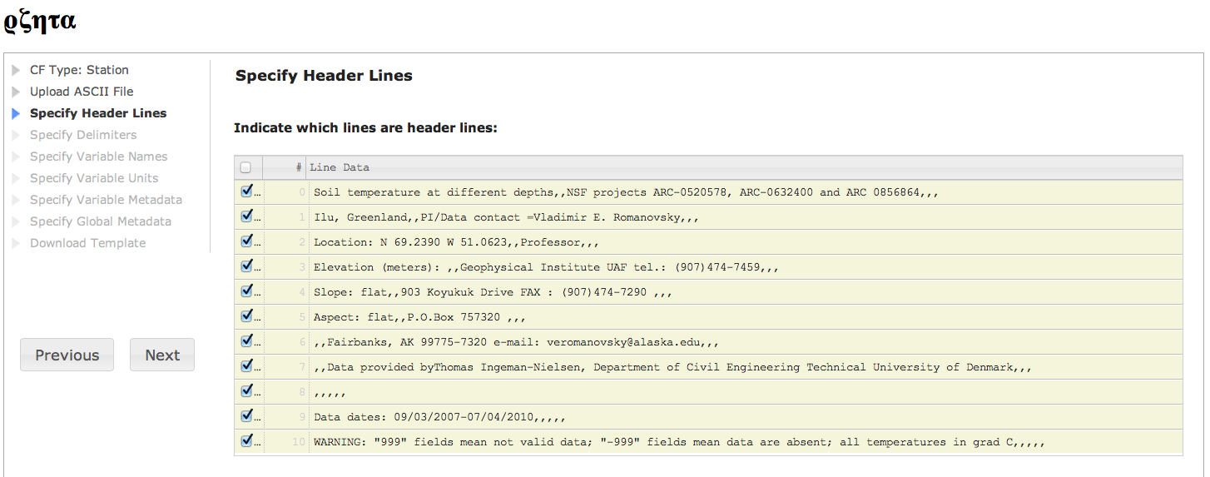
ρζητα

Slide 16
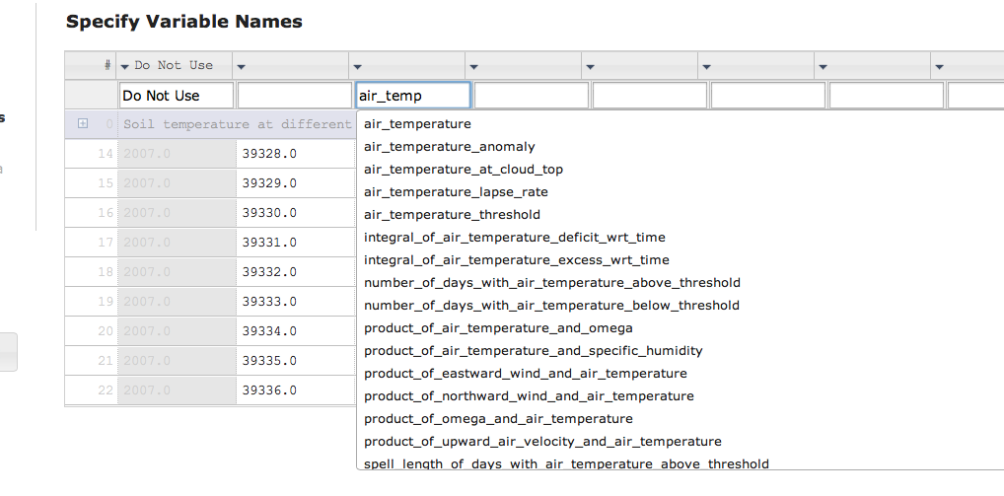
ρζητα

Slide 17
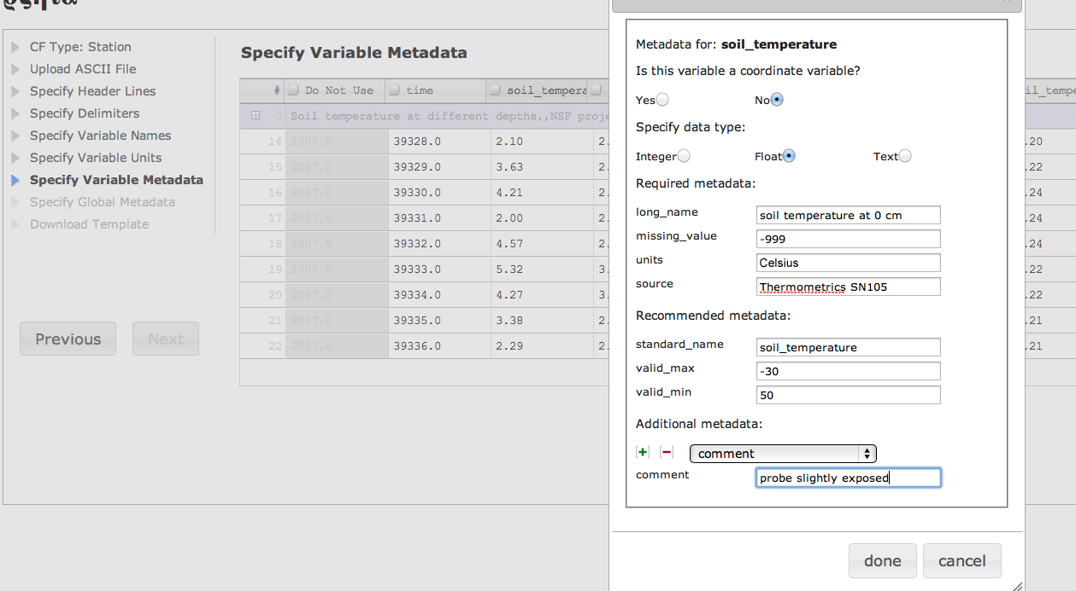
ρζητα

Slide 18
THREDDS Data Server
Servlet Container
catalog.xml
Remote Access
Client
THREDDS Server
WCS
OPeNDAP
HTTPServer
WMS
NetCDF-Java
Library
configCatalog.xml
IDD Data
Datasets
thredds.ucar.edu

Slide 19
Data Access Services
Bulk File Transfer
HTTP Server (any file)
Remote access, subsetting CDM files
OPeNDAP (any* CDM file)
Web Coverage Service (grids)
Web Map Service (grids)
Others
NetCDF Subset Service (grids)
Radar Collection Subset Service
CDM Remote Service

Slide 20
Data Access Services Clients
OPeNDAP
IDV, Ferret, GrADS, NCO, NCL
IDL, MatLAB
WCS
GDAL, CADCorp, George Mason, OWSLib
WMS
Browsers, Portals, ARC GIS, Google Earth, etc
NetCDF Subset Service
HTML forms interface
Web service (CUAHSI)
ESRI ArcGIS (manual download of netcdf-CF)

Slide 21
OPeNDAP Service
Protocol for remote, subset access to CDM files
Current version 2.0; NASA ESE standard
Working on new 4.0 protocol spec
TDS can serve any* CDM file
Subsetting by variable, index range

Slide 22
OGC Web Coverage Service (WCS)
TDS supports WCS 1.0
Can subset the dataset by:
Lat/lon or projection bounding box
time and vertical coordinate range
list of Variables
Return formats
GeoTIFF floating point, grayscale
NetCDF/CF-1.0
No reprojections, resamplings
Restricted to Gridded Datasets the CDM recognizes
Additional WCS restriction:
Grid must be evenly spaced in x,y

Slide 23
OGC Web Map Service (WMS)
TDS WMS:
Supports WMS 1.3.0 and WMS 1.1.1
Based on ncWMS (Jon Blower, Univ of Reading)
Returns map images
Can also return information about a particular map pixel (e.g., a timeseries at a given map pixel)
ncWMS notable features
Fast generation of images
Ability to read CDM datasets on variety of projections
Can reproject images into large number of coordinate systems
WMS specification supports 4D data (tools often do not)

Slide 24
NetCDF Subset Service
Allow to subset the dataset by:
Lat/lon bounding box
time and vertical coordinate range
list of Variables
Output: NetCDF, XML, CSV
Gridded Data
Output is a CF-netCDF file
Variation of WCS (simplified request protocol)
Grid as Point Datasets
Extract vertical profile, time series from one point in model data

Slide 25
Metadata Services ncISO
Developed by NOAA/NGDC
Supports three metadata services
Provides an NcML representation of a dataset
Provides an ISO 19115-2 metadata representation of a dataset
Provides an evaluation of how well the metadata contained in the dataset conforms to the NetCDF Attribute Convention for Data Discovery (NACDD)

Slide 26
Aside 3: Marcos Hermida

Slide 27

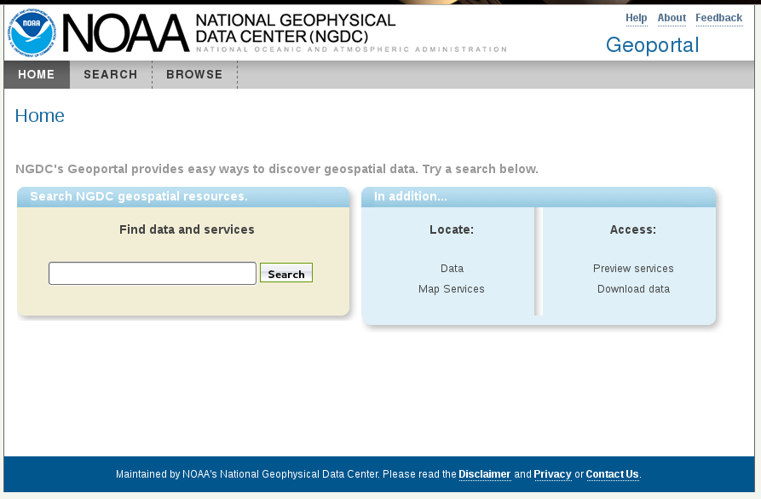
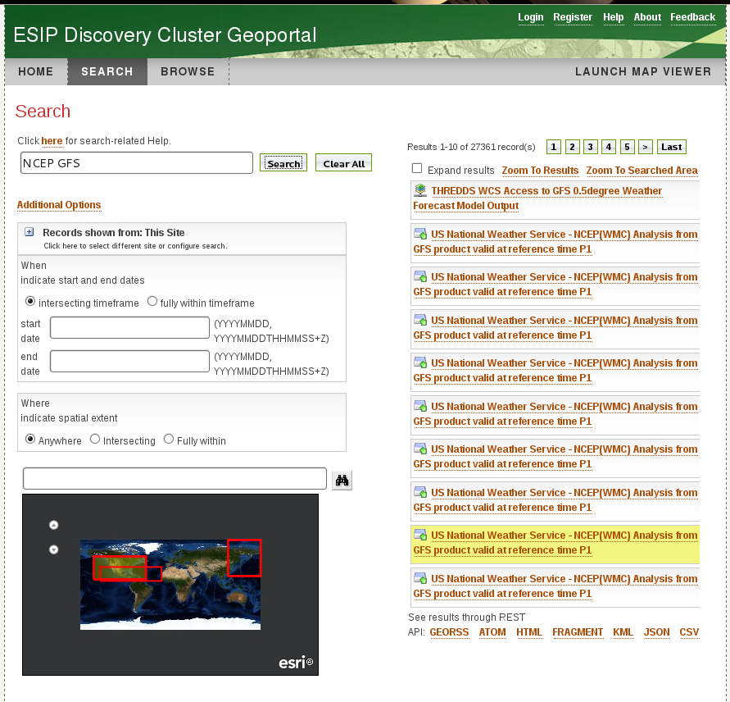
Metadata & ncISO services
Enables discovery systems to perform searches on TDS instances

Slide 28
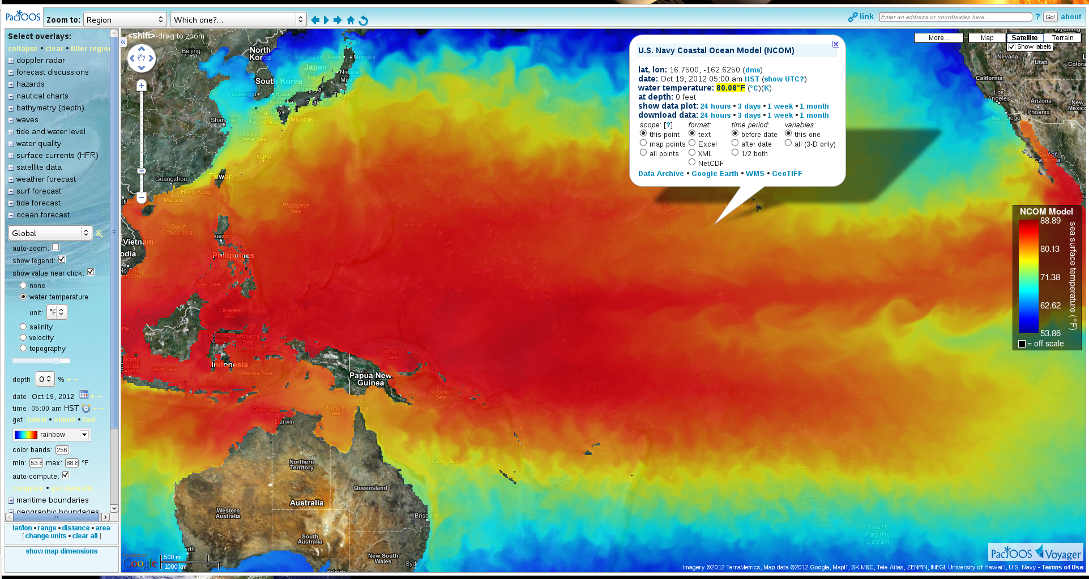
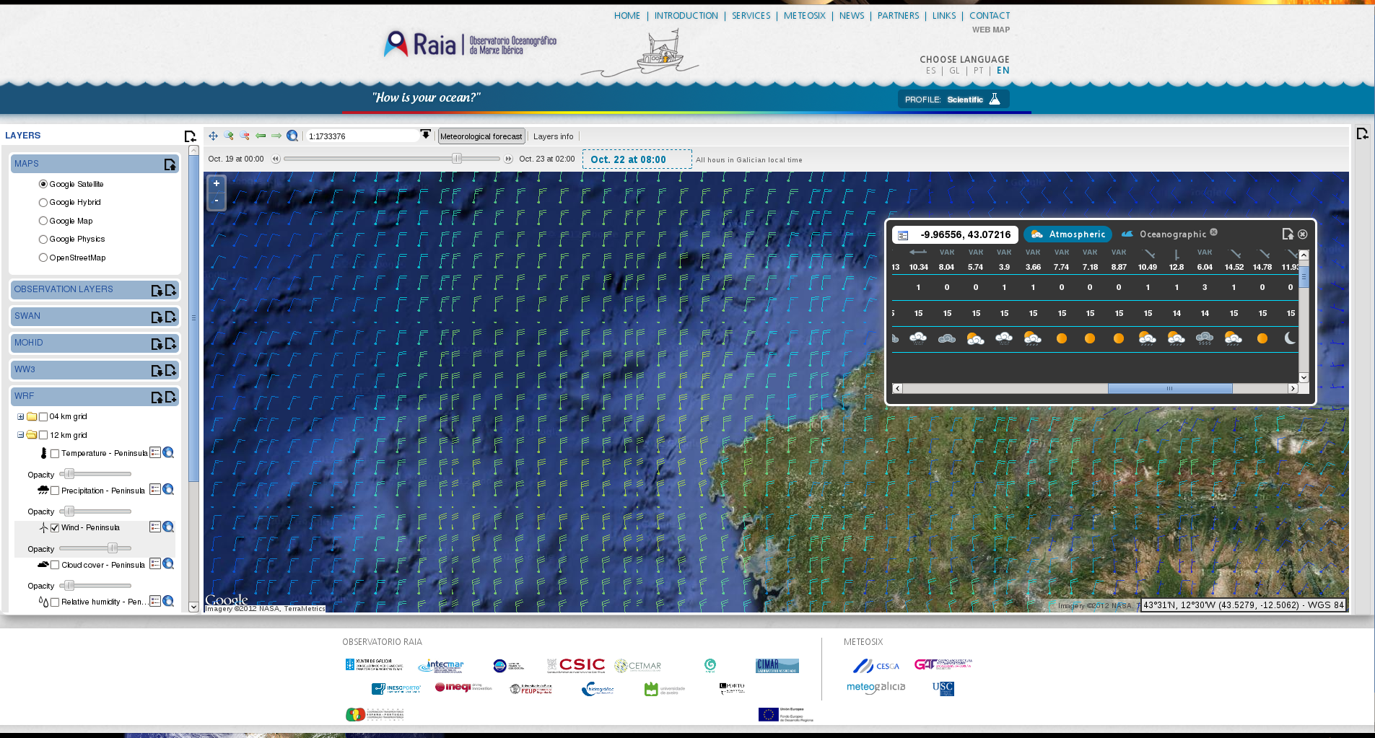
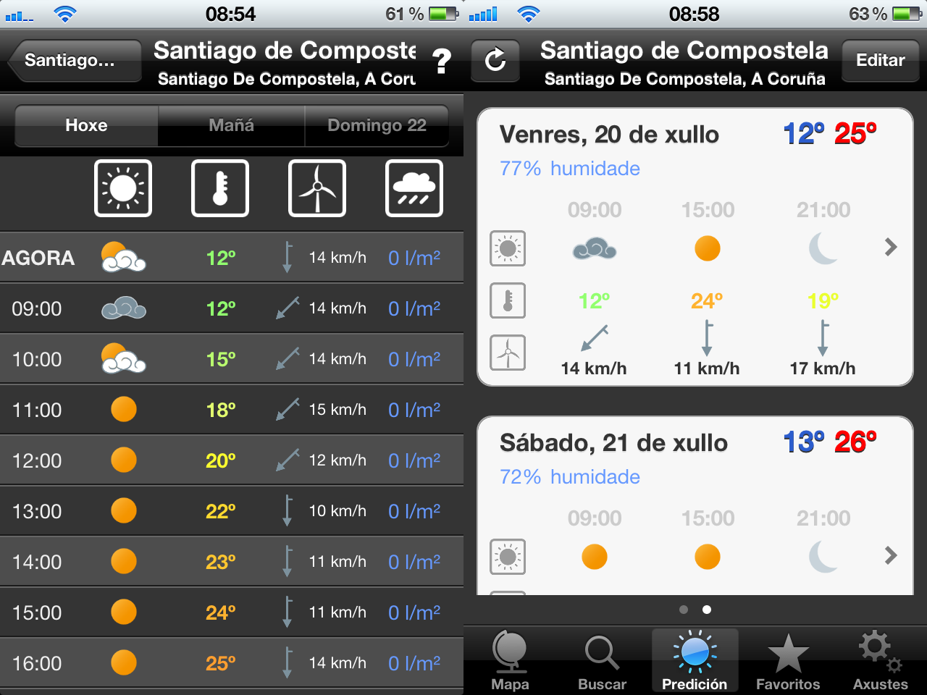
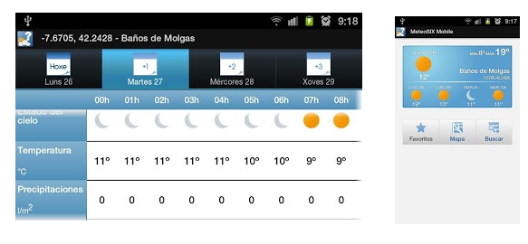
NetCDF Subset Service (NCSS)
- API for subsetting datasets

Slide 29
THREDDS Data Server
Servlet Container
catalog.xml
Remote Access
Client
THREDDS Server
WCS
OPeNDAP
HTTPServer
WMS
NetCDF-Java
Library
configCatalog.xml
IDD Data
Datasets
thredds.ucar.edu

Slide 30
Configuration Catalogs
Administrator tells the TDS which / how datasets are to be served
Identify the files on disk
Name, organize, sort, filter into virtual collections
Add discovery metadata
Integrated with NcML
Create virtual datasets

Slide 31
TDS Configuration Catalogs
…
<datasetScan name="Ocean Satellite Data“
path="/data/ocean/sat/"
location= "/data/tds/netcdf/">
<metadata inherited="true">
<serviceName>odap</serviceName>
<dataType>Grid</dataType>
<dataFormat>NetCDF</dataFormat>
<documentation xlink:href="http://ncep.noaa.gov/modelinfo/index.html"
xlink:title="NCEP Model documentation" />
<documentation type="processing_level">
Transmitted through Unidata Internet Data Distribution.
</documentation>
</metadata>
</datasetScan>
…

Slide 32
TDS and NcML
NcML: an XML representation of netCDF.
Can “fix” metadata problems
Can augment metadata
Can aggregate datasets
General Aggregations: joinNew, joinExisting, Union
Specialized aggregations:
Forecast Model Run Collection (FMRC)
Point Feature Collections
Embed NcML into the TDS configuration catalog
Server serves a virtual dataset defined by NcML
NcML hidden from the client
Notes:
The TDS can use NcML to wrap datasets that are being served, adding or fixing metadata. The client doesn’t see the NcML, it sees only the dataset the NcML describes. The NcML aggregation capability is what the TDS uses as the replacement to the old OPeNDAP aggregation server.

Slide 33
TDS / NcML Modify and serve through TDS
<dataset name=“Polar Orbiter Data" urlPath =“idd/sat/PolarData“ >
<netcdf location="/data/sat/P02393.hdf”>
<attribute name="Conventions" value="CF-1.4"/>
<variable name="Reflectivity" orgName=“R34768”>
<attribute name="units" value=“dBZ" />
<attribute name=“coordinates" value=“time lat lon" />
</variable>
</netcdf>
</dataset>

Slide 34
THREDDS Data Server
Servlet Container
catalog.xml
Remote Access
Client
THREDDS Server
WCS
OPeNDAP
HTTPServer
WMS
NetCDF-Java
Library
configCatalog.xml
IDD Data
Datasets
thredds.ucar.edu

Slide 35
Next Up: TDS Configuration
Basic Configuration
Configuration Catalogs
threddsConfig.xml
More Configuration Catalogs

Slide 37
Gridded Data
Cartesian coordinates
Data is 2,3,4D
All dimensions have 1D coordinate variables (separable)
float gridData(t,z,y,x);
float t(t);
float y(y);
float x(x);
float z(z);
netCDF: coordinate variables
OPeNDAP: grid map variables
HDF: dimension scales

Slide 38
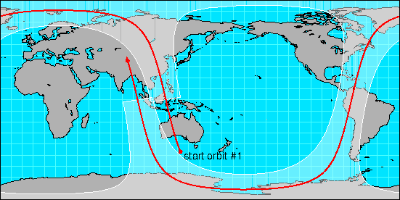
Swath
two dimensional
track and cross-track
not separate time dimension
aka curvilinear coordinates
float swathData( track, xtrack)
float lat(track, xtrack)
float lon(track, xtrack)
float alt(track, xtrack)
float time(track)

Slide 39
Point Observation Data
Set of measurements at the same point in space and time = obs
Collection of obs = dataset
Sample dimension not connected
float obs1(sample);
float obs2(sample);
float lat(sample);
float lon(sample);
float z(sample);
float time(sample);

Slide 40
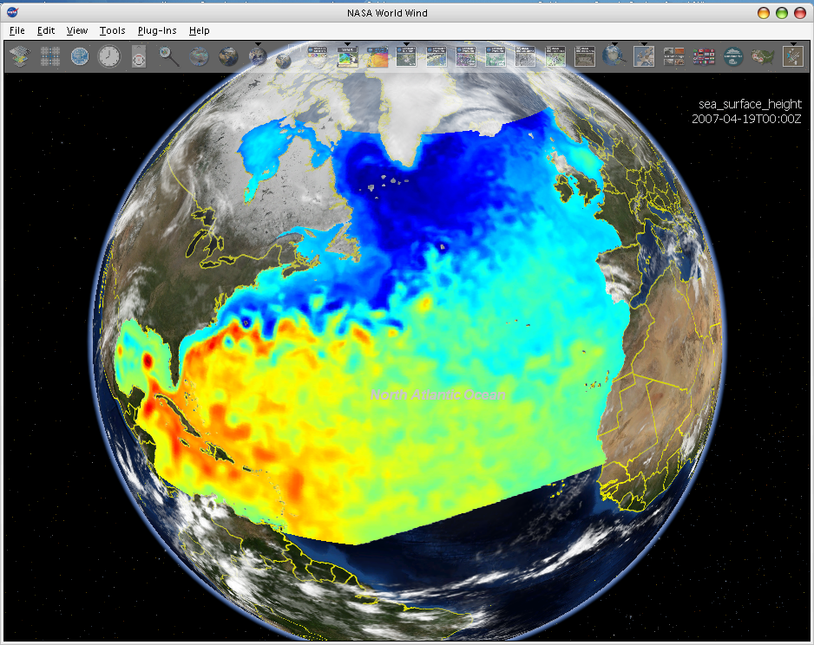
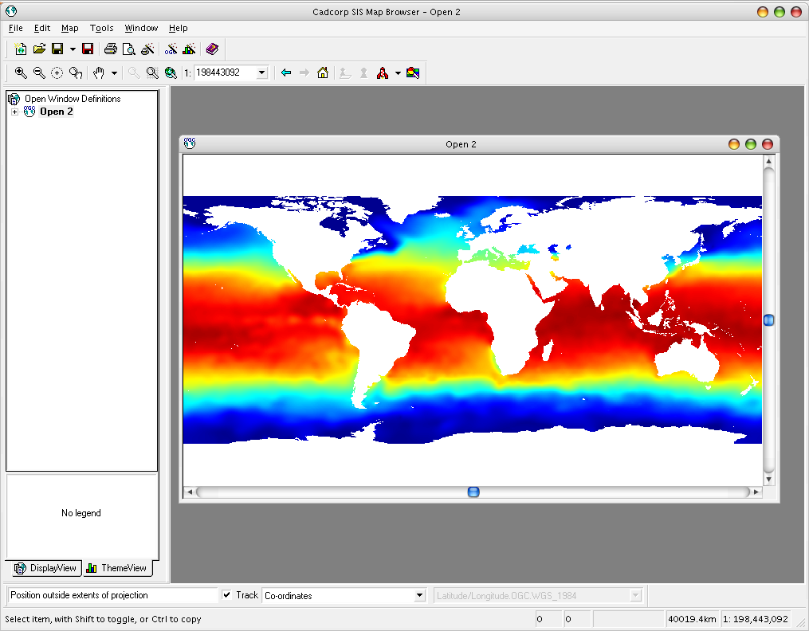
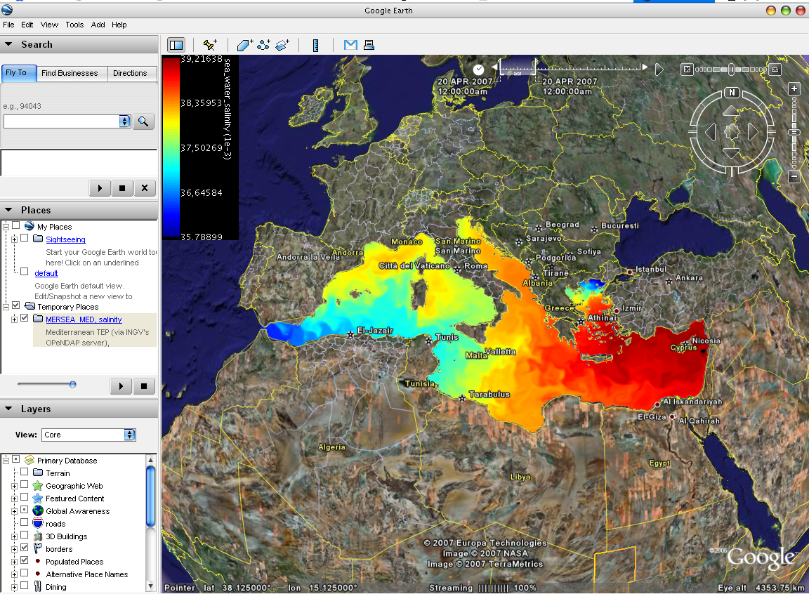
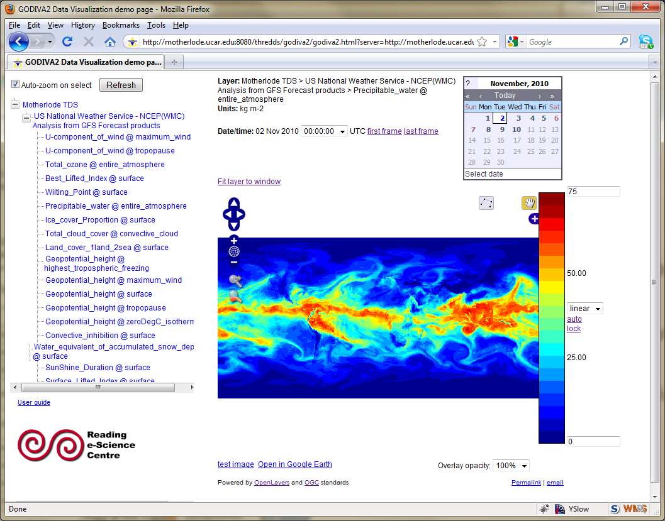
WMS Interoperability
NASA World Wind
3rd-party clients can’t use the custom WMS extensions
Cadcorp SIS
Google Earth
Godiva 2

Slide 41
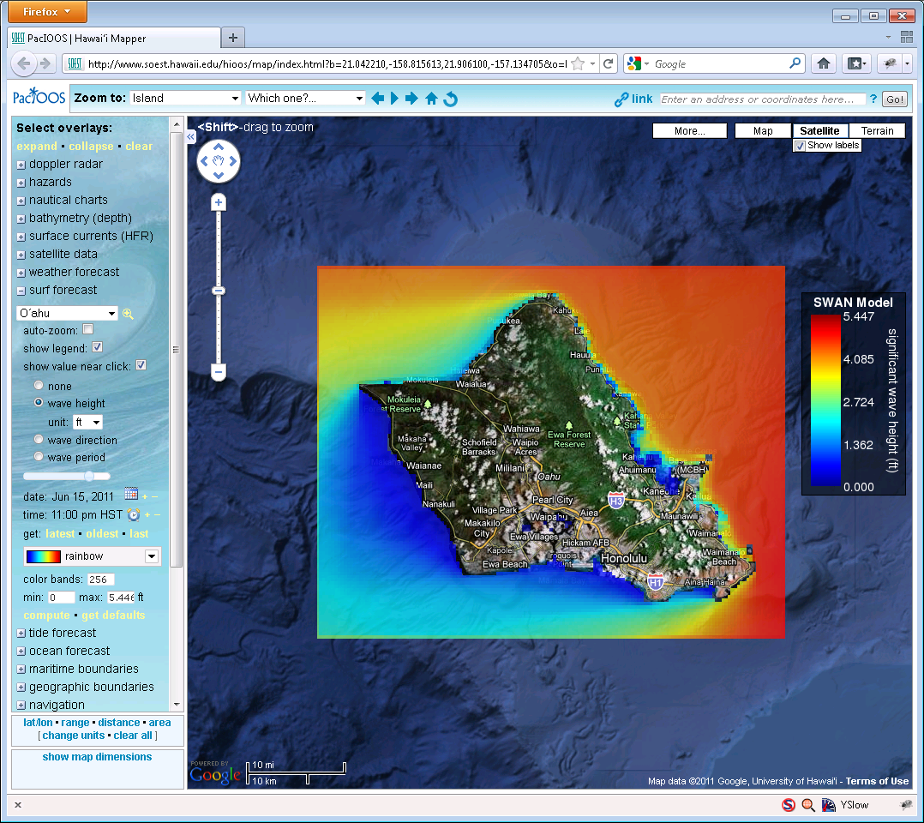
Using WMS and NCSS
* From PacIOOS site, developed by John Maurer, U of HI

Slide 42
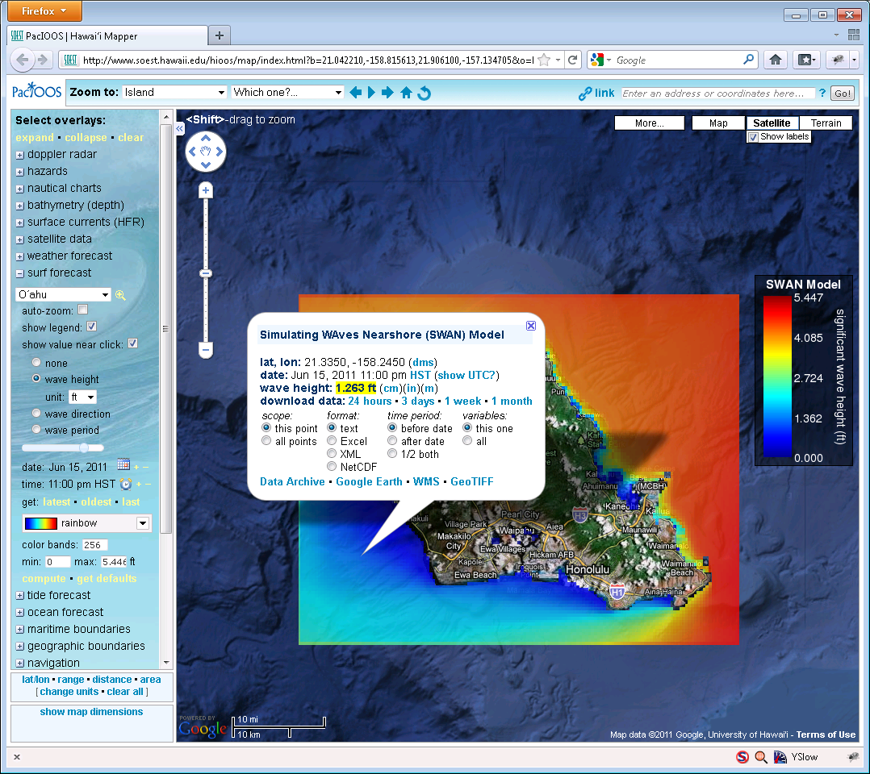
Using WMS and NCSS
* From PacIOOS site, developed by John Maurer, U of HI

